Slide 1
Data Science Test
Shashank Bassi

Slide 2
Business Problem
Given data of purchase history per user, predict who is going to make a purchase in next month

Slide 3
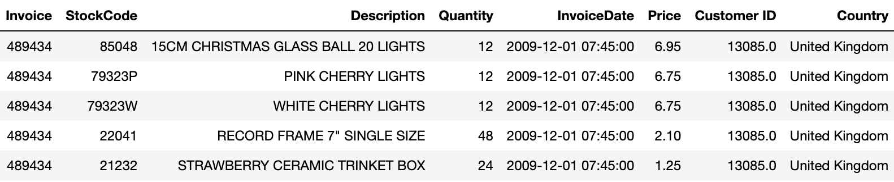
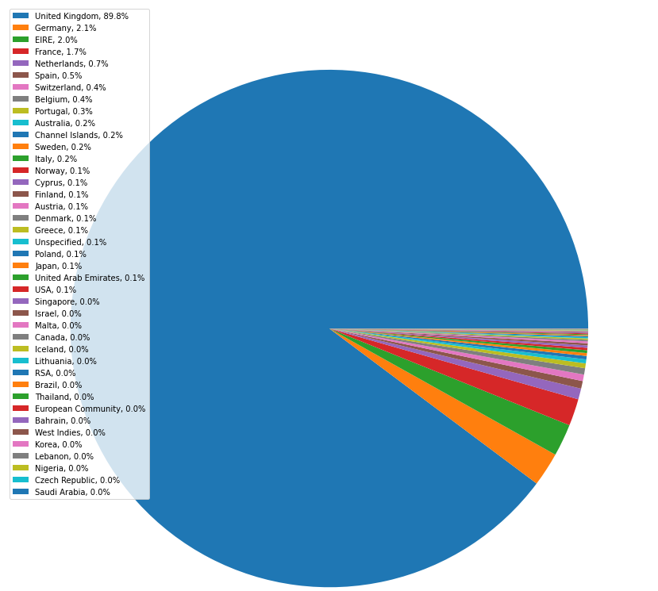
Input Data & Features

Slide 4
Data Cleaning
CustomerID has null records. Dropped rows containing null values
Quantity column has negative values, which may be due to returning products after a purchase. Dropped rows with a negative quantity
Price column has negative records. Dropped records with negative price
Calculated TotalPrice by multiplying Quantity and Price

Slide 5
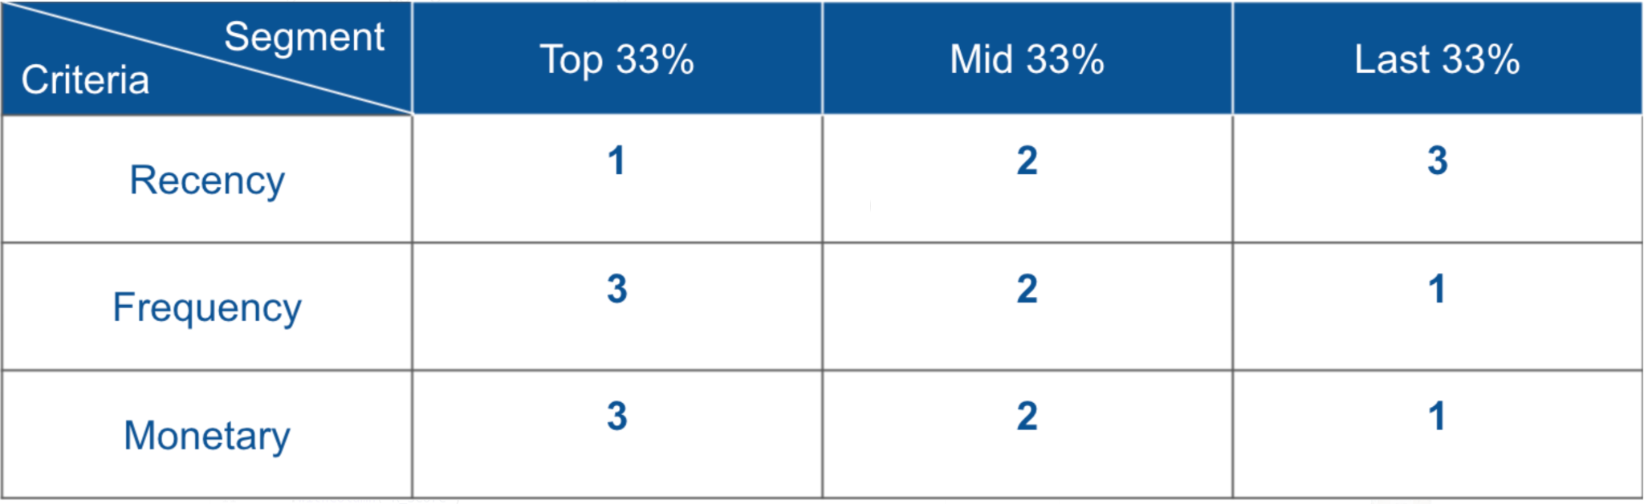
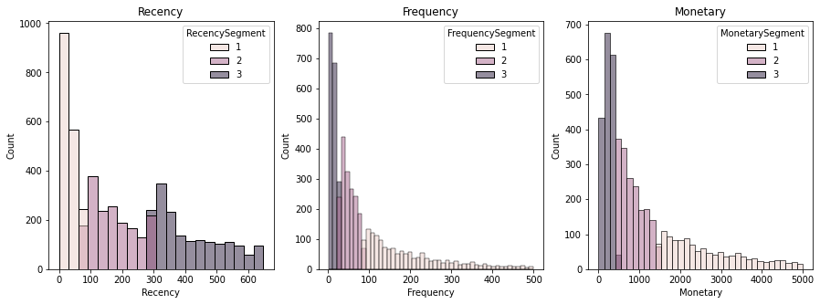
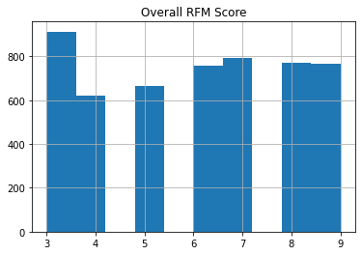
Features
Recency Frequency Monetary Based
behavior-based customer segmentation
can help to predict who will respond to promotions and future personalization services
Recency: minimum number of recency days
Frequency: number of purchases the customer has made
Monetary: total value of all purchases for each customer

Slide 6
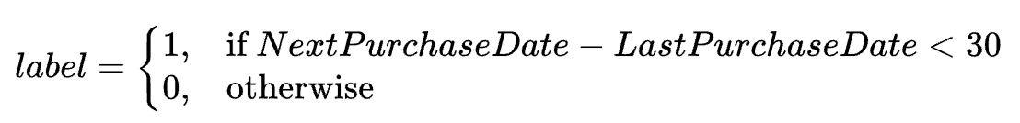
Experiment Setup
Last Purchase Date
Next Purchase Date
Train
History
Label(30 days)
Test
History
Label(30 days)

Slide 7
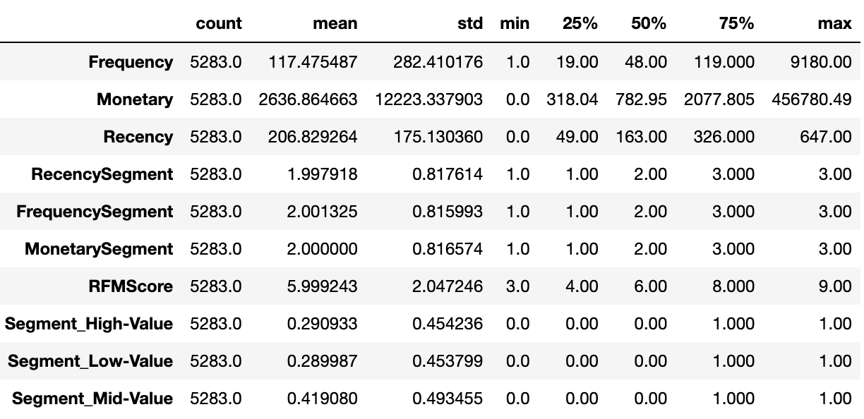
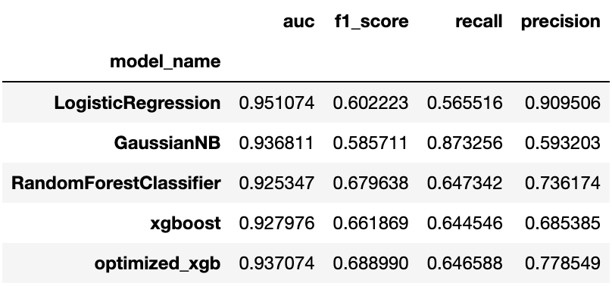
Modeling Results

Slide 8
Conclusion
UK has most number of transactions
RFM features are very predictive in this case
Train test is split in a way as per time-series setting and not mixed cross-validation. This test can be done over many more test intervals and results could be averaged
RandomForest, Xgboost seems to show really good performance even more after optimizing hyper-params

Slide 9
Future Ideas
Predict time range confidence interval, for inventory optimization
Item related feature engineering based on demand planning, seasonality, cardinality
Categorize features into fast, medium, slow moving and then build separate models

Slide 10
Questions?

